Slide 1
Bringing the Analog World to Digital Design
Team member:
Conor Naughton
Bin Xu
Yimin Xu

Slide 2
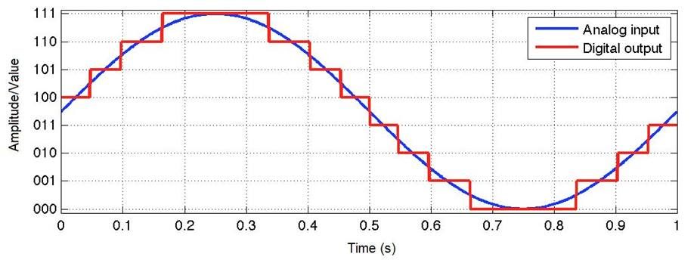
Goals
Explore the use of analog signals
Deep dive into how Analog to Digital Converters (ADCs) work
Motivation
FPGAs work with digital signals however the tasks they are used for often involves analog inputs
Requires interacting with and controlling another component of the development board (Analog to Digital Converter (ADC))

Slide 3
Short Functionality
Describe game, rules
Balloons speed up after certain number of points
Additional balloons coming in

Slide 4
Short Specification

Slide 5
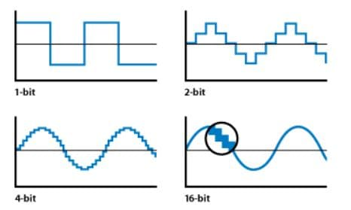
Analog to Digital Converter (ADC)
What is an ADC?
HW that takes in an analog signal and converts it to a digital output
In other words, it changes an analog signal that is continuous in terms of both time and amplitude to a digital signal that is discrete in terms of both time and amplitude
How does an ADC work?
Analog input is sampled at a certain frequency
Sample is quantized into a digital value by comparing with a reference voltage
12-bit ADC => 4096 quantization levels
How does ADC sampling work?
Choose sample rate so the digital output accurately reflects the input (≥ 2x the fastest input frequency)
Max sample rate 1MSPS
Illustration of analog input being approximated by a digital output
Illustration of quantization levels

Slide 6
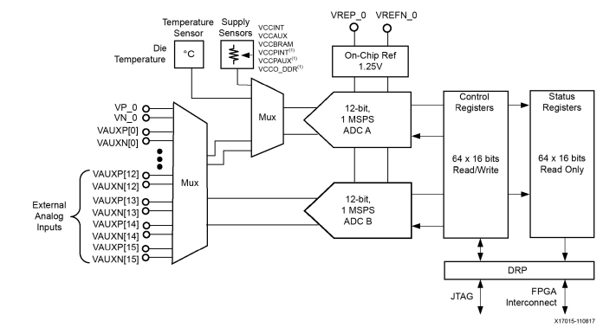
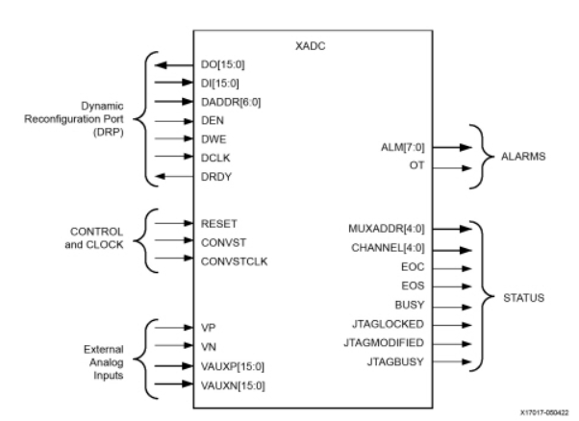
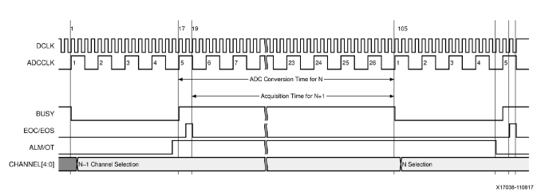
Further ADC Details
What are the peripheral components to the ADC?
Input mux
Status and control registers
Reference generator
DRP Interface
What parameters define how the ADC works?
Channel averaging
Unipolar and differential measurement

Slide 7
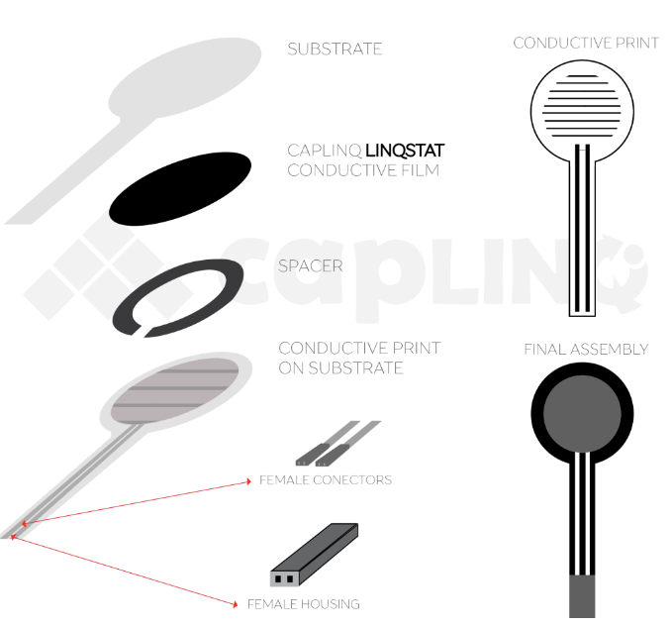
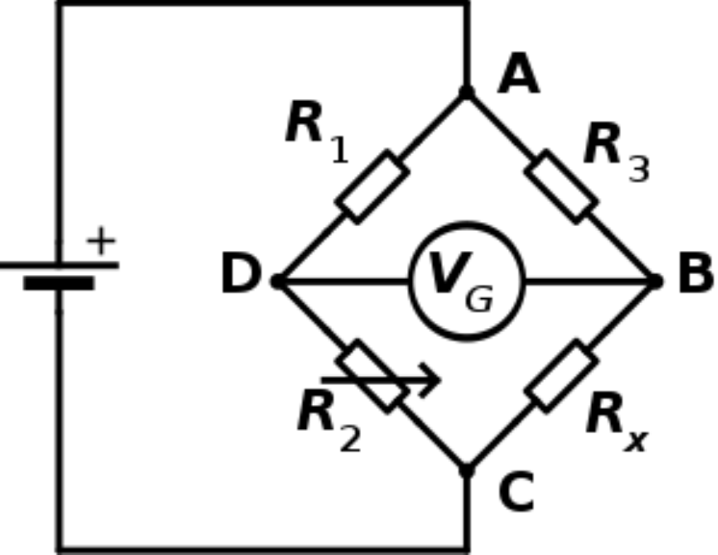
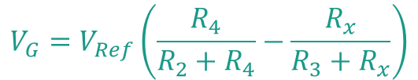
Force Sensitive Resistor (FSR)
FSR is an electrical component which changes its resistance when a force or pressure is applied.
Composed by two substrate layers sandwiching together a conductive film and a spacer.
The substrate layer which is on the spacer side also has a conductive ink printed on it.
When force is applied to the sensor, the conductive film is deformed against the substrate and air is pushed out of the spacer causing the conductive film to come into contact with the conductive print on the substrate. The more of the conductive ink area touching the conductive film, the lower the resistance.
Not very differentiable (i.e. basically a 1 or 0)
Solution: Wheatstone Bridge
Breakdown of Force Sensitive Resistor
$$V_{G}=V_{Ref}\left(\frac{R_{4}}{R_{2}+R_{4}}−\frac{R_{x}}{R_{3}+R_{x}}\right)$$
Wheatstone Bridge with a variable resistor Rx

Slide 8
Detailed Functionality-Game [Bin]
How did we change the game?
How do we use the output of the ADC

Slide 9
Detailed Functionality-Memory [Yimin]
What were we planning on doing with the memory?
Why didn’t it work?
How does Quad SPI flash work?
What did we end up doing instead?

Slide 10
Detailed Block Diagram [Bin]

Slide 11
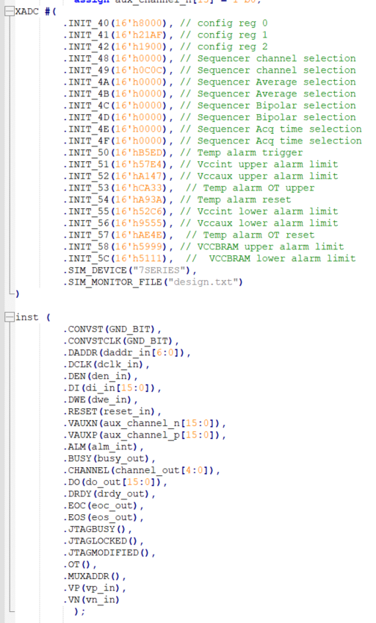
Verilog Example [Conor]
ADC instantiation
Explain DRP connection
Annotate code with simple comments of functionality
The DRP is the interface between the ADC and FPGA through which the FPGA can access the ADC registers

Slide 12
Successes
Analog game
Pressing harder makes it move faster
Attribution of successes

Slide 13
Failures
Use of Quad SPI flash memory
Timing issues of direction change versus ADC settling
Explain what we tried for each of these

Slide 14
References
https://github.com/Digilent/Nexys-A7-100T-XADC

Slide 15
From update presentation

Slide 16
Path Forward
Game Code Base [Bin Xu]
Change out button input for ADC output [11/11]
Start with simple threshold and maintain single step of paddle
Change from single step to step proportional to ADC output [11/18]
ADC [Conor N]
Figure out how to make measurements more differentiable [11/4]
Likely replace with a load cell but in the mean time, try to find an EE solution
Characterize measurement repeatability, fidelity [11/9]
Finalize gameplay setup and demonstrate functionality [11/18]
Quad SPI Flash [Yimin Xu]
Combine the flash controller into game memory

Slide 17
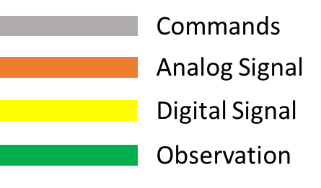
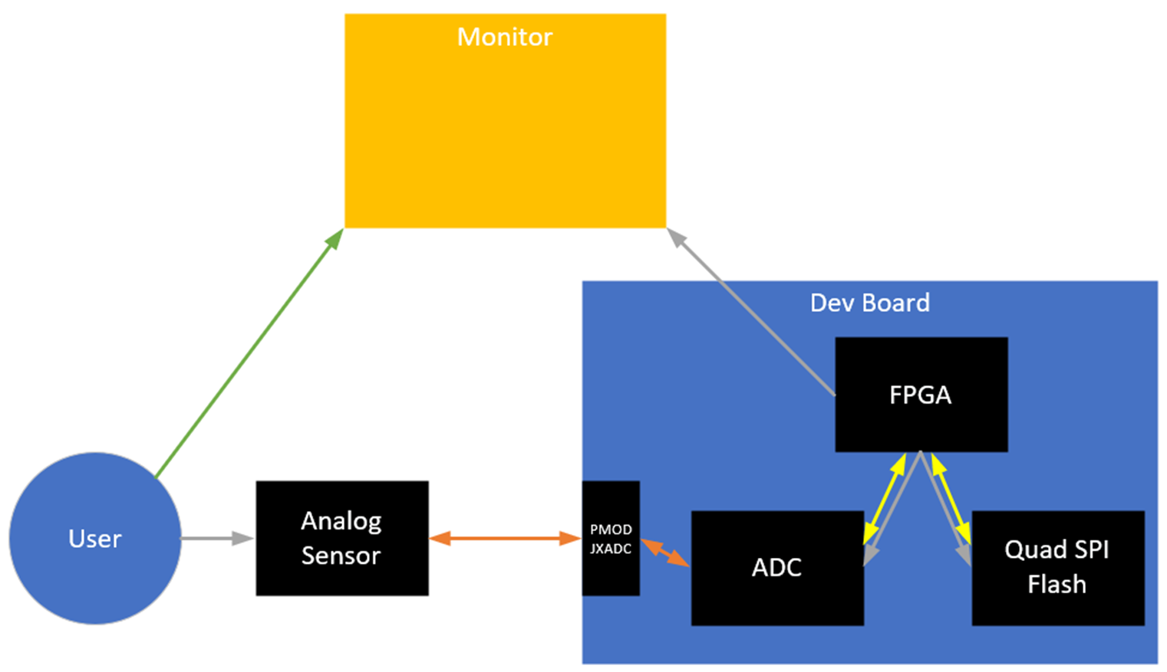
High Level Diagram

